Slide 1
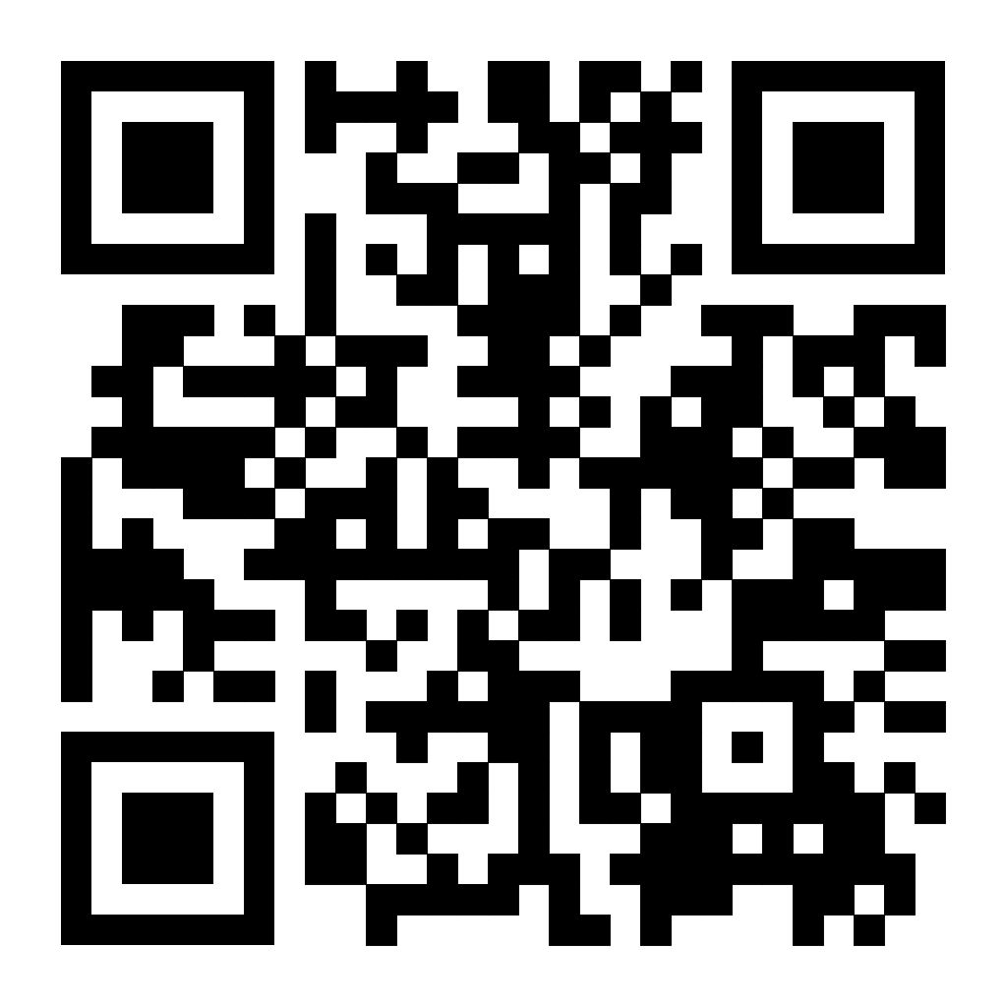
The New England Patriots, the American International Women's Club e.V., and Frankfurt RheinMain GmbH cordially invite you to a Benefit Reception for Frauennotruf Frankfurt.
Please reserve your spot to join us on July 12th, 2023, at Main Suites in Frankfurt from 7-10 pm by contributing your €100 donation for Frauennotruf Frankfurt.
You can expect to meet several former players, cheerleaders, and the mascot, along with a grill buffet accompanied by beer, wine and bubbles!
The New England Patriots will match donations for Frauennotruf and give away 2 tickets to their game in Frankfurt on November 12th, 2023, against the Colts.
Address: Karpfenweg 26 · 60327 Gutleutviertel

